Slide 1
Istanbul medipol University language school
MANUAL FOR MICROSOFT TEAMS

Slide 2
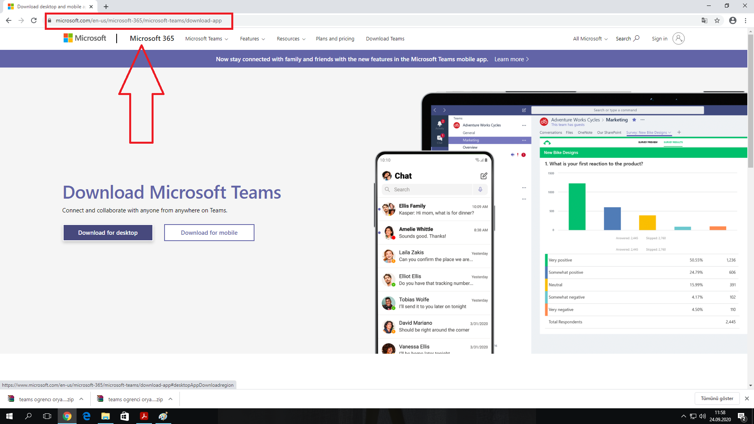
Go to Microsoft Teams website

Slide 3
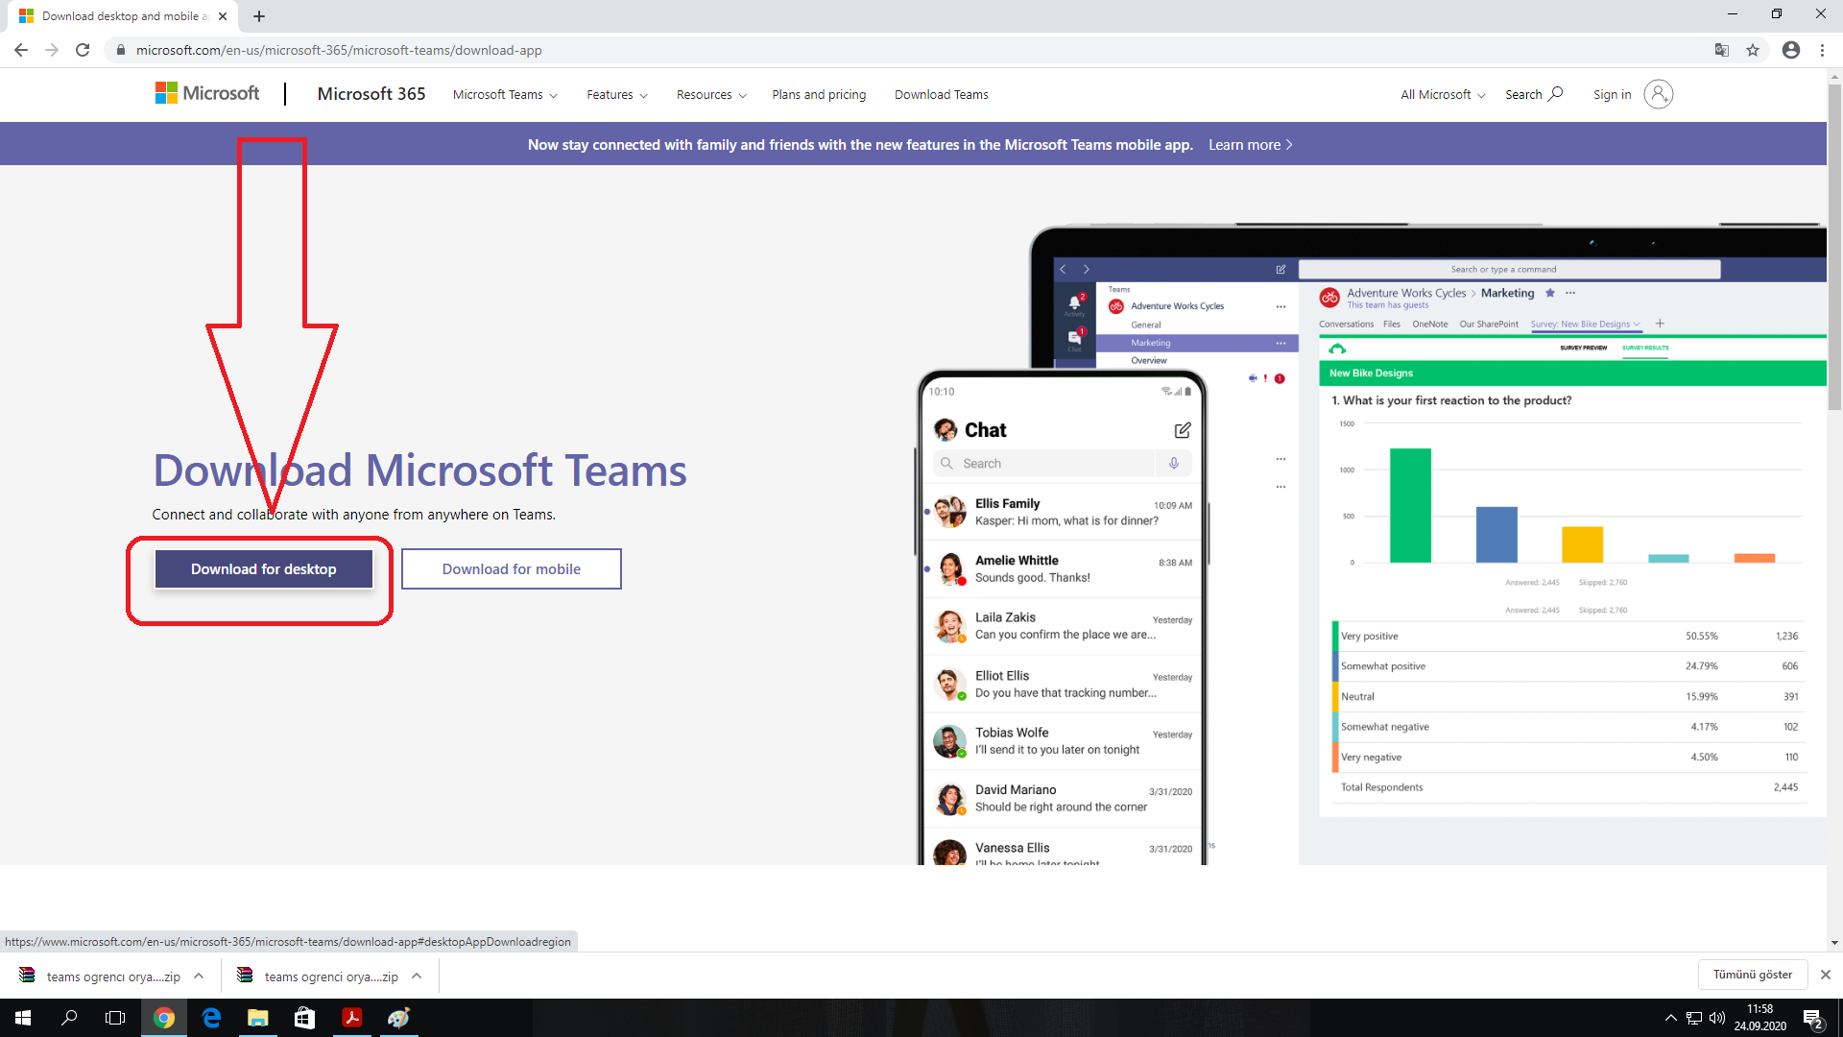
Download and install the Microsoft Teams app for desktop

Slide 4
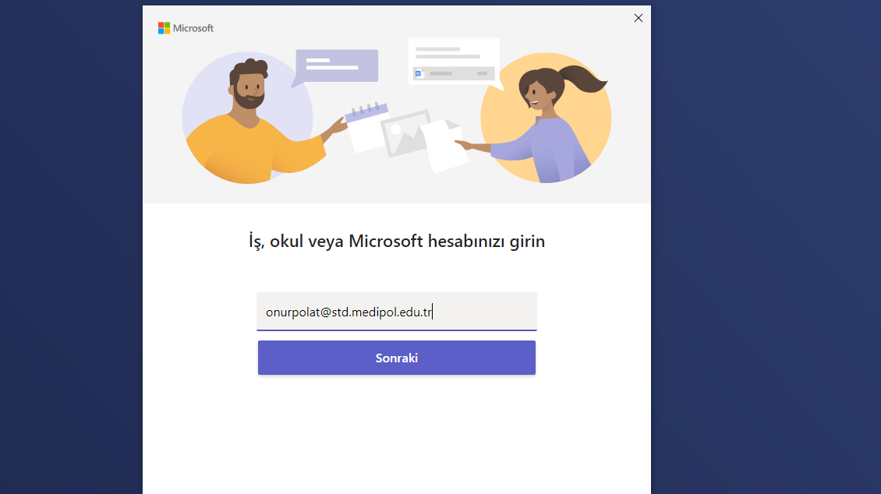

After installing the app, open the Microsoft Teams app, with your MEDIPOL E-MAIL ADRESS and MEBIS PASSWORD

Slide 5
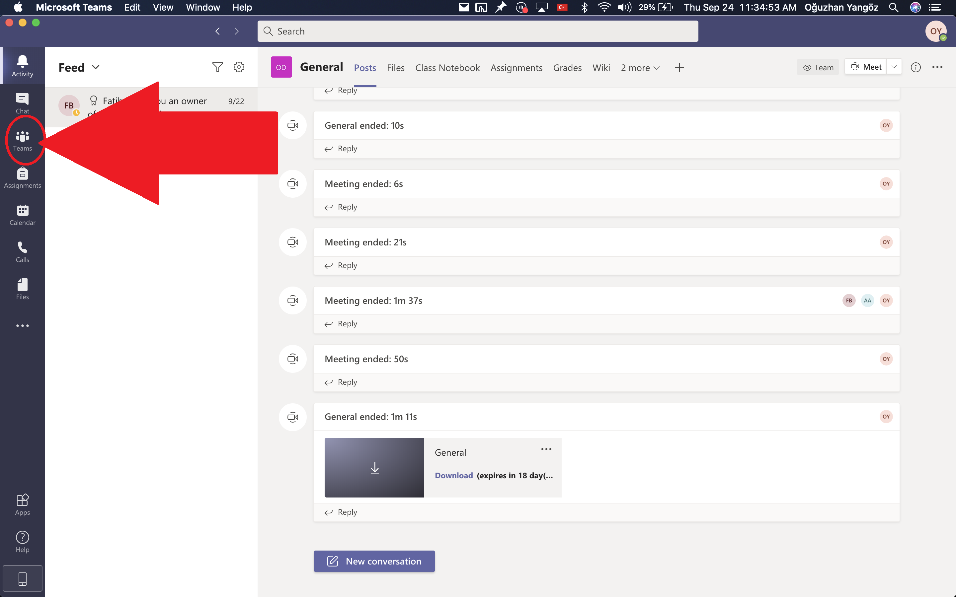
After installing the app, open the Microsoft Teams app, and click on «Teams» on the left panel.

Slide 6
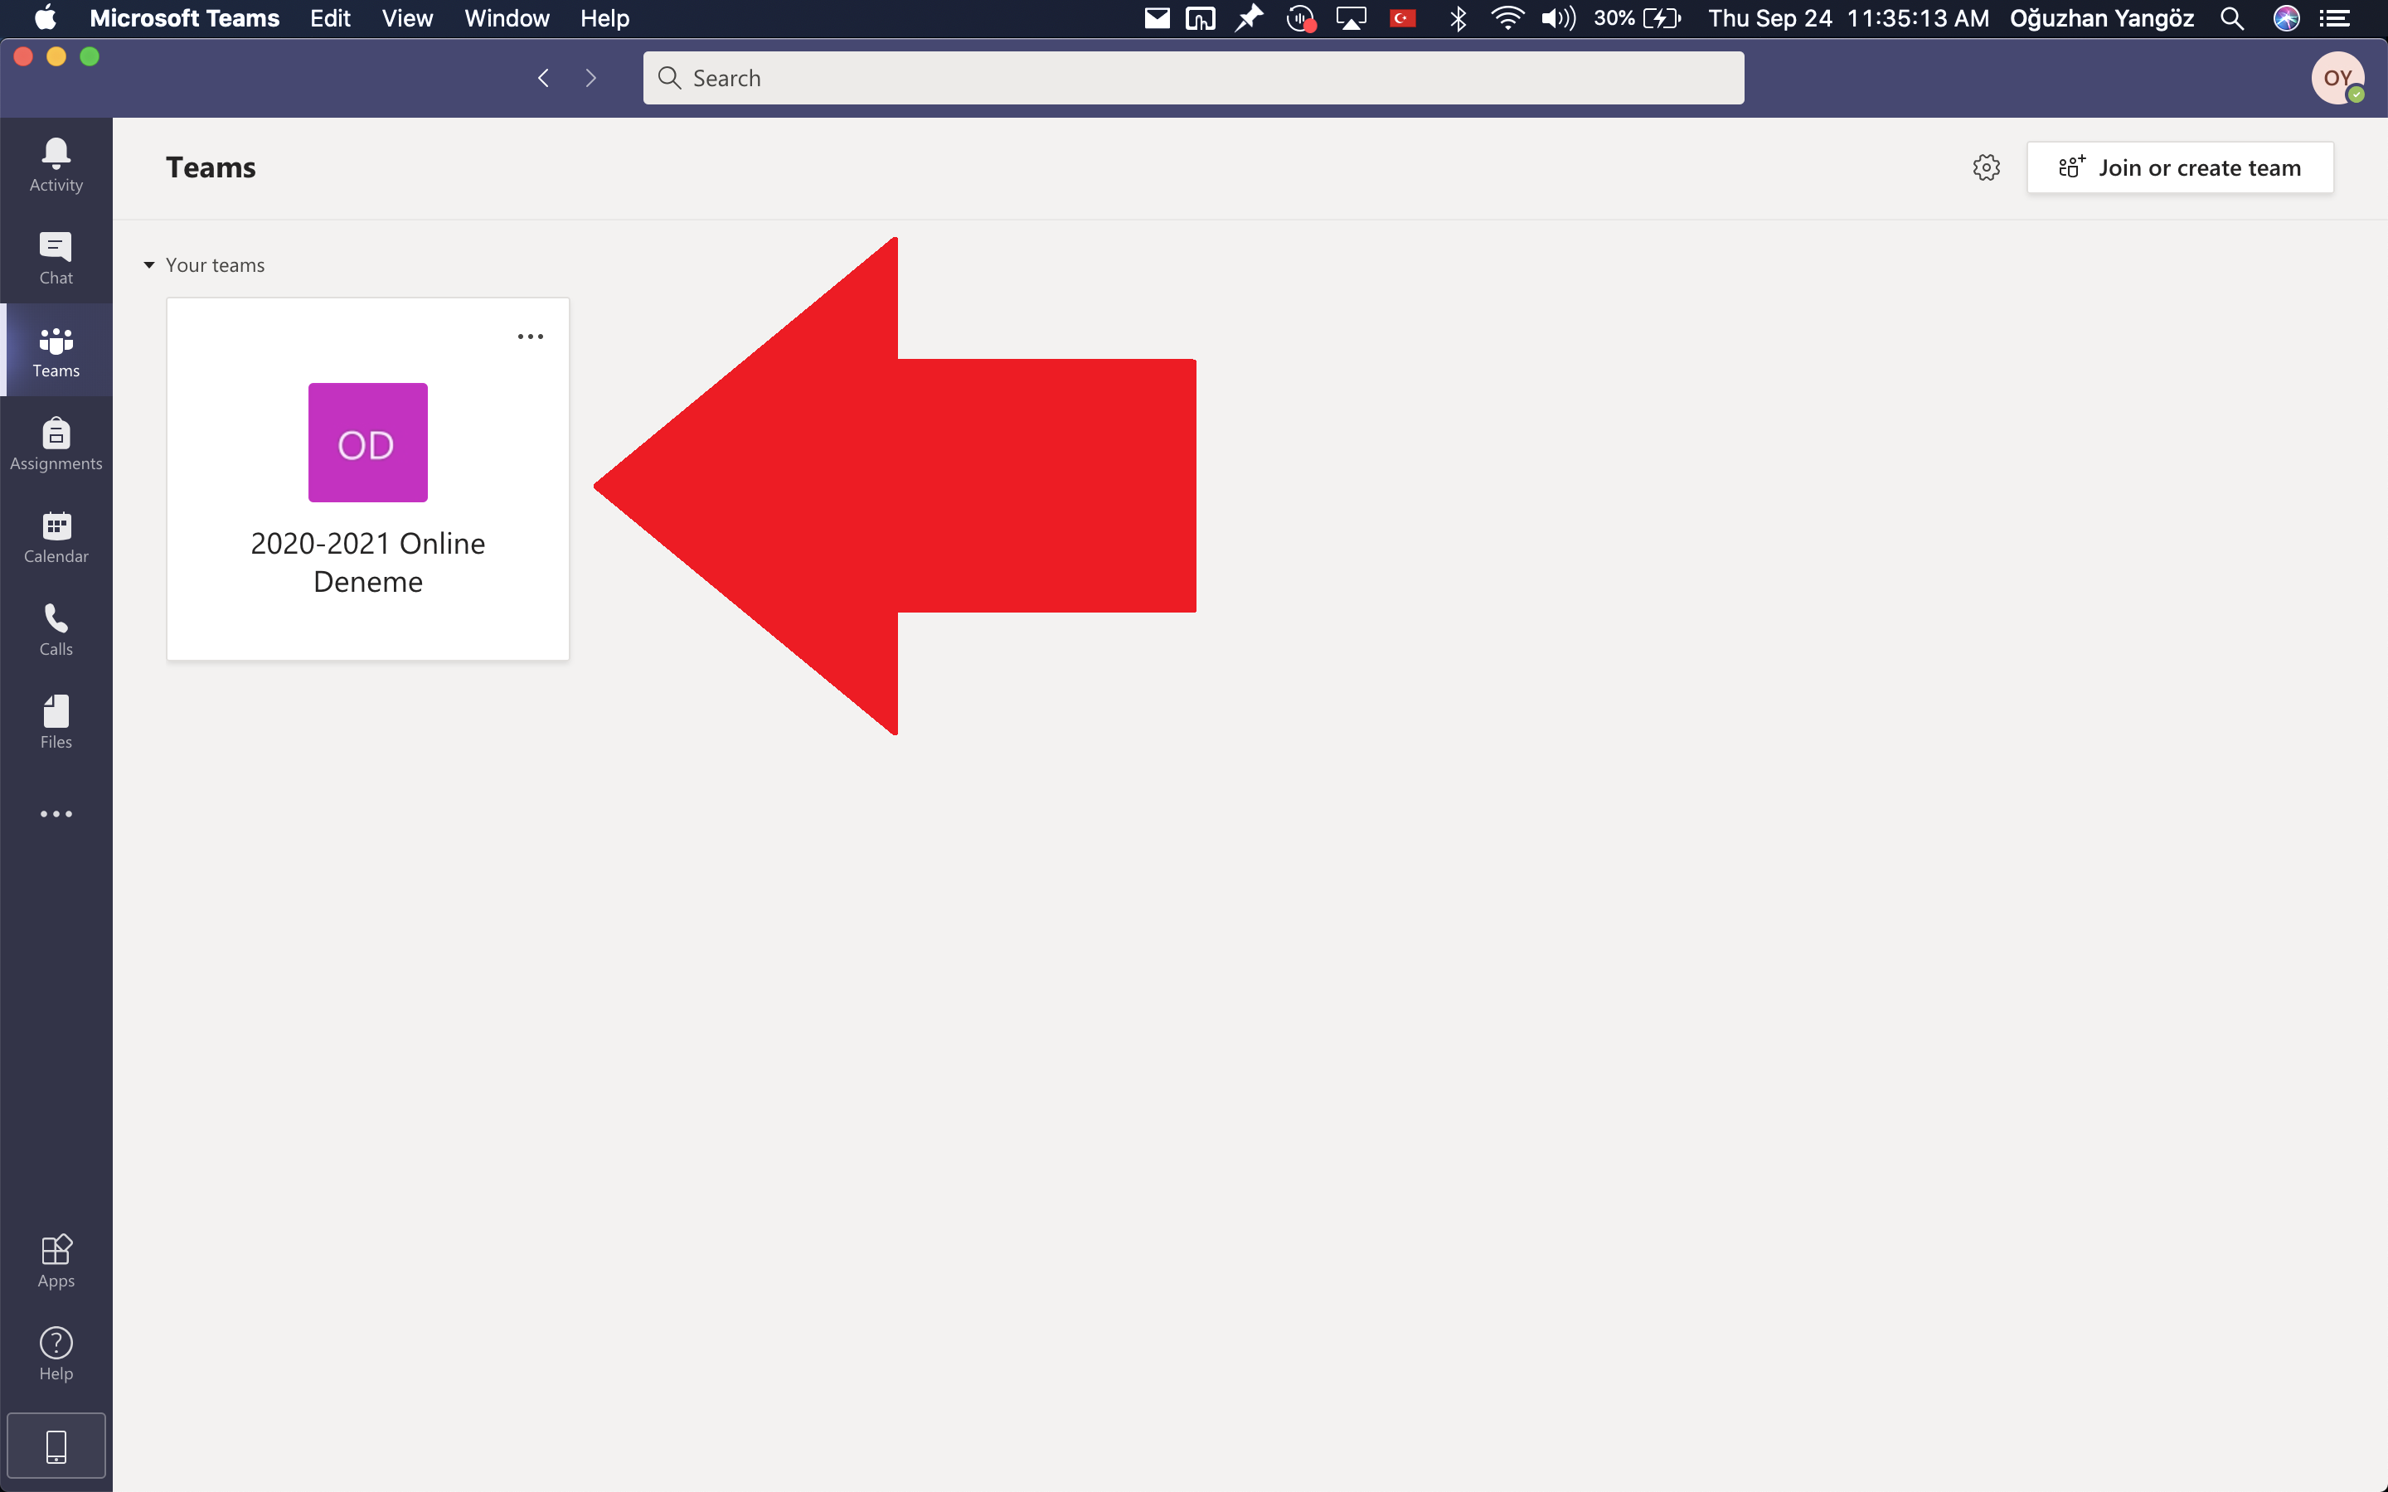
At the «Teams» section, you will find your class. Double-click to open

Slide 7
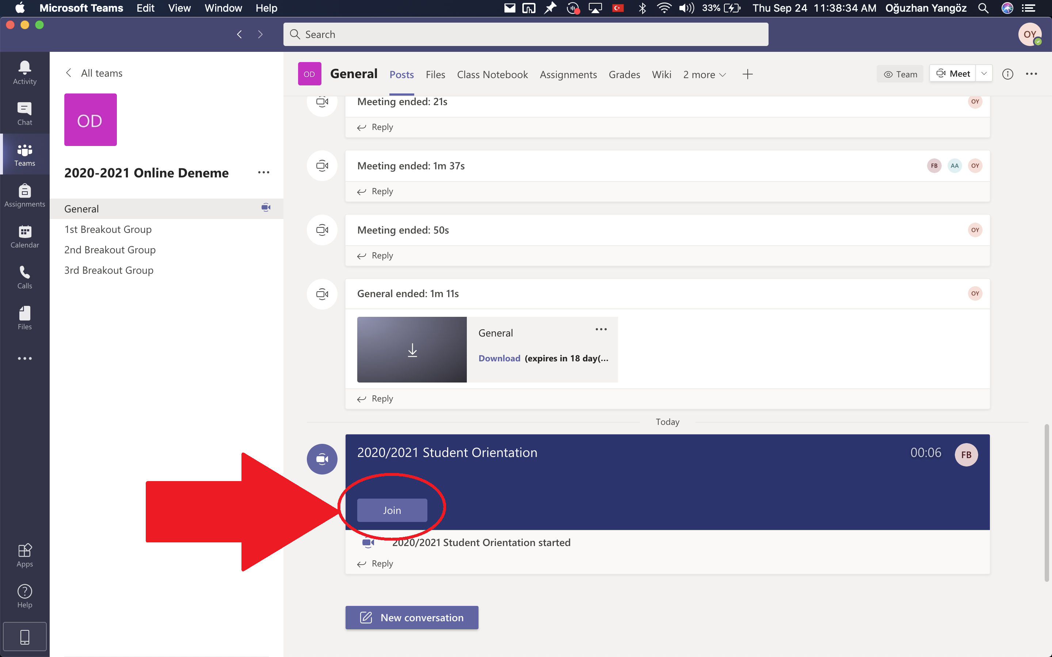
When the lesson starts, you will see this. Click on «Join» to join the meeting.

Slide 8
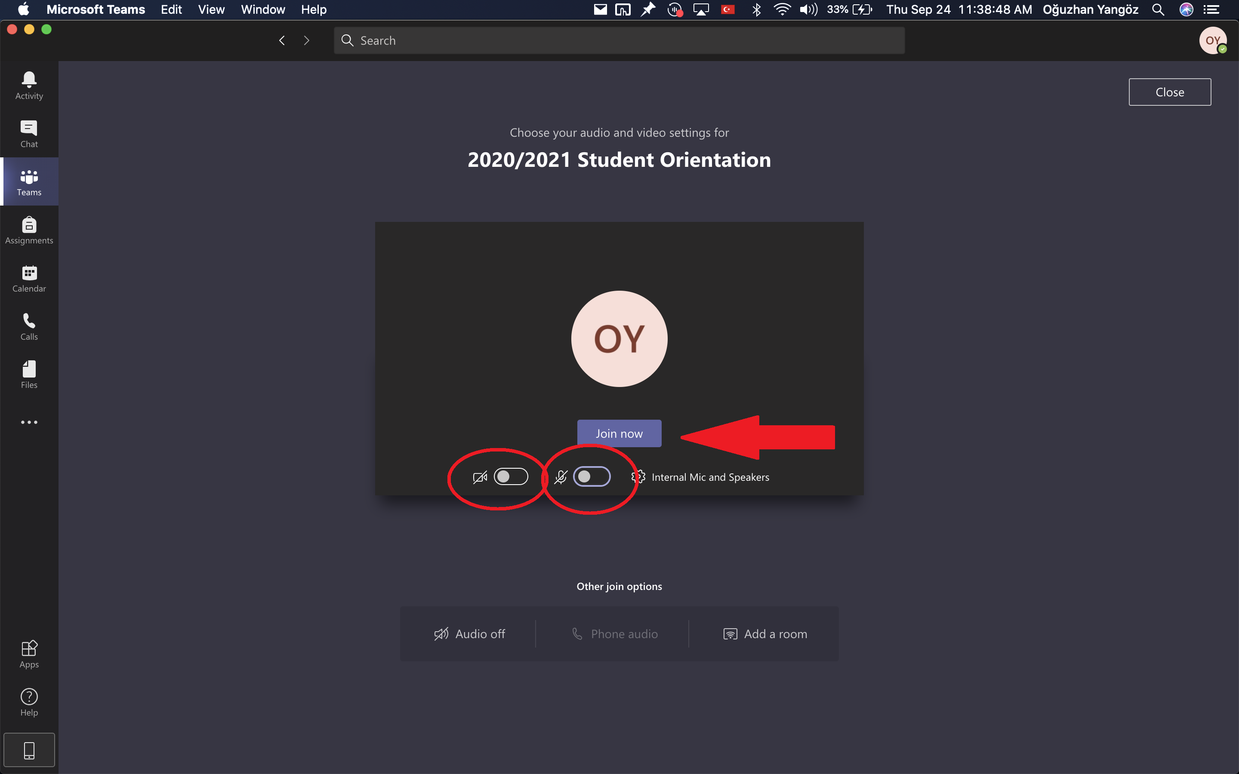
Before you are connected, this screen will pop up.
Make sure your microphone and camera are off when you are connecting to the meeting
Click on
«Join now»

Slide 9
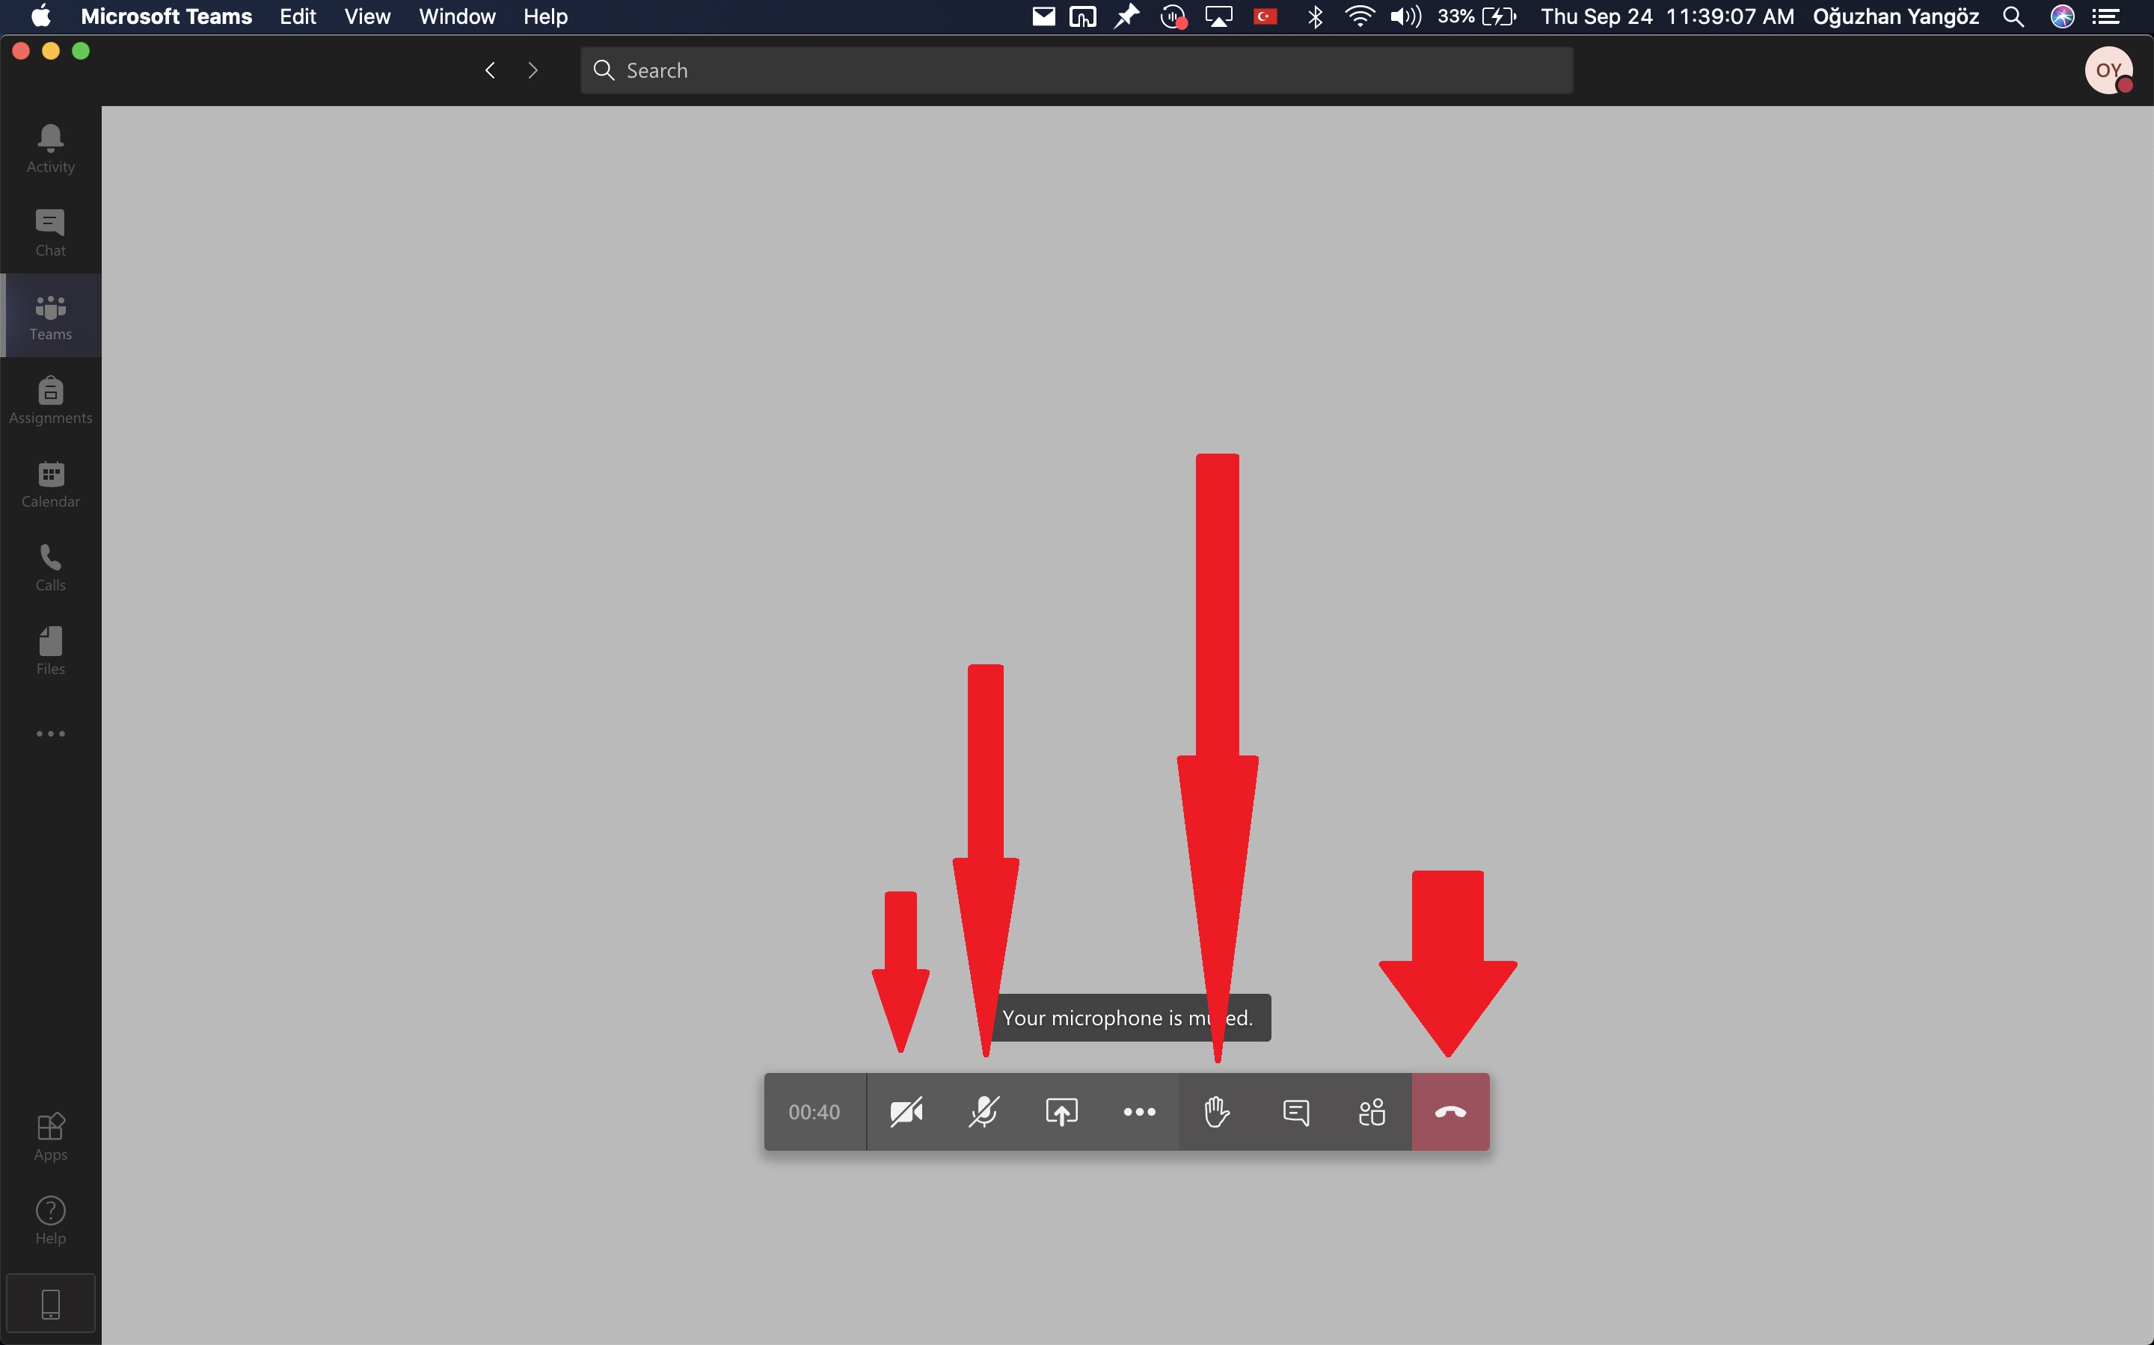
When you are listening, please keep your camera and microphone off.
When you want to say something, you can click here to raise your hand. Click again to put it back down
Turn the microphone on when you want to speak, then after you finish speaking, turn it back off
Click here to exit the lesson

Slide 10
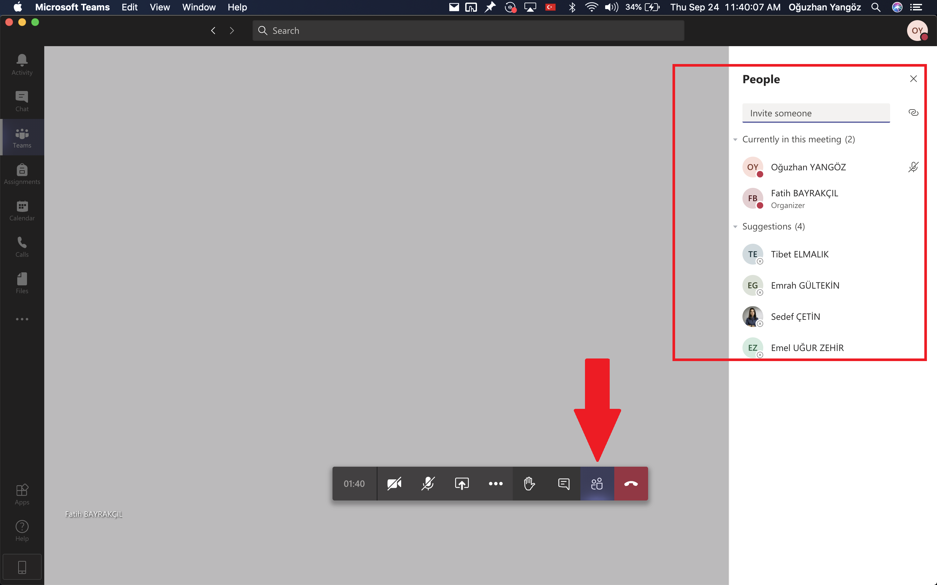
By clicking on this icon, you can see the people currently at the lesson

Slide 11
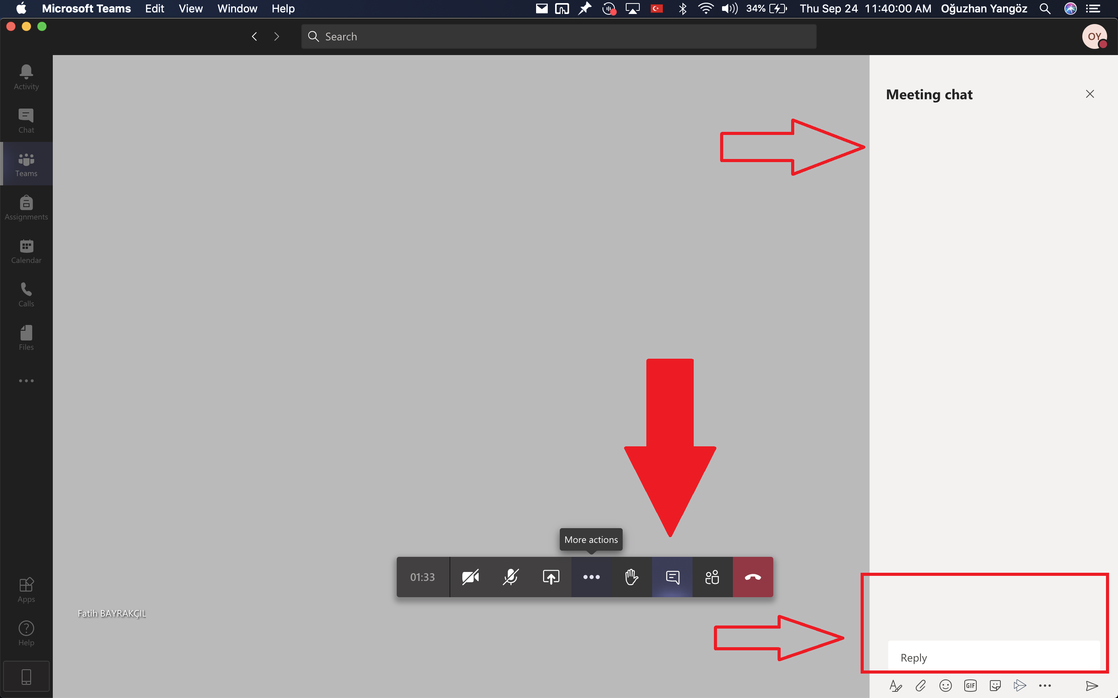
By clicking on this icon, you can open the chatbox to write messages or see other people’s messages

Slide 12
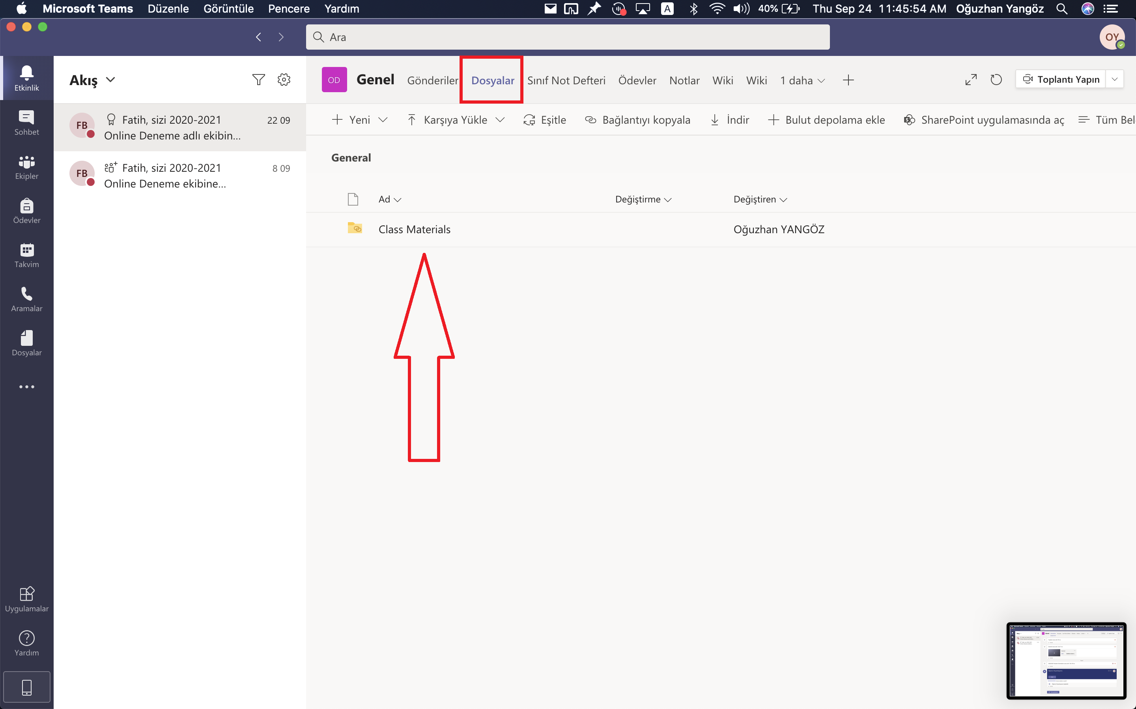
To access files your teacher uploads onto Teams, click on «Files» in the class menu and click on Class Materials

Slide 13
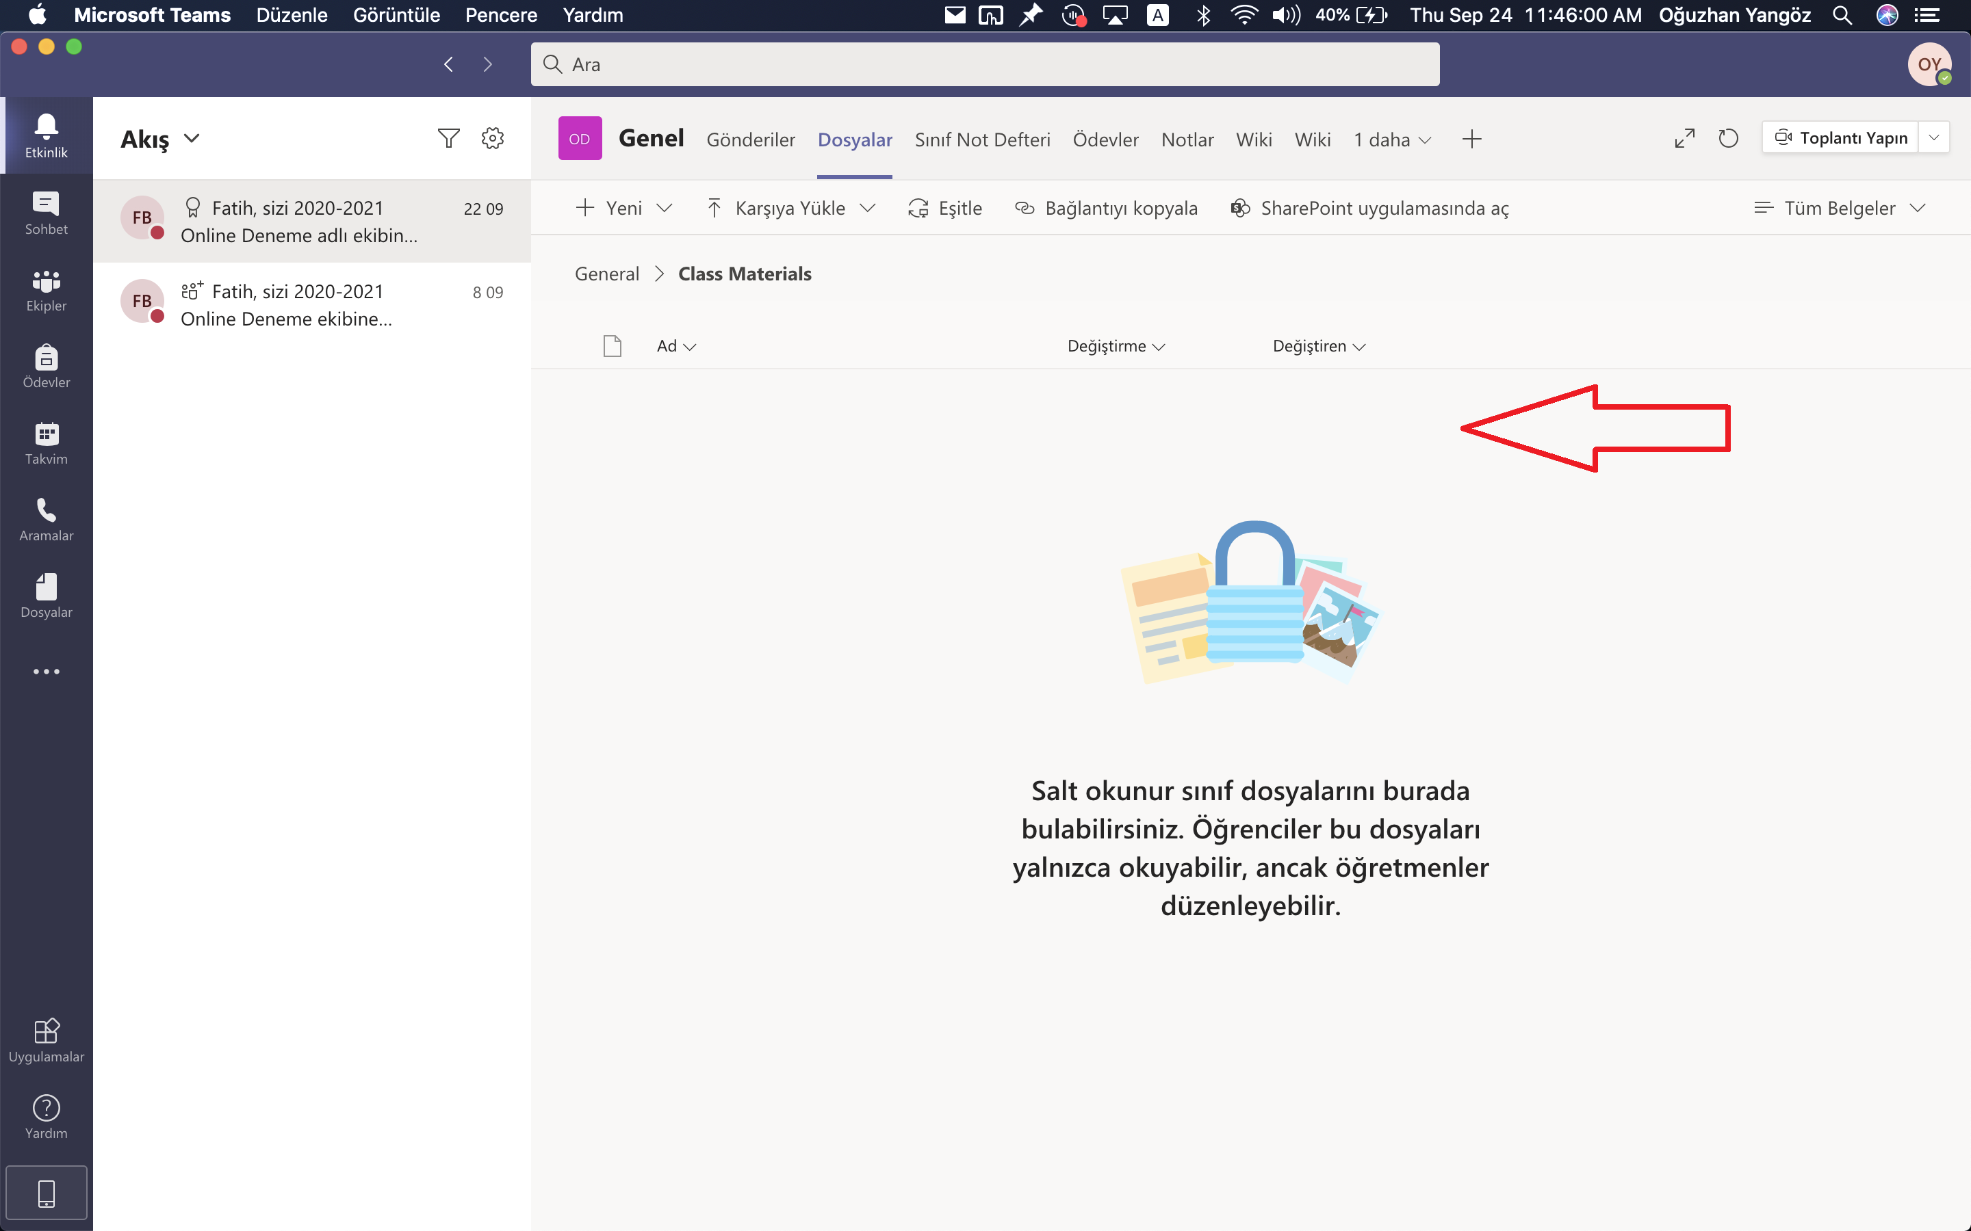
Your teacher will upload the files here.

Slide 14
If you have problems wıth mıcrosoft teams, send an e-maıl to mebısdestek@medıpol.edu.tr

