Slide 1
FREQUENTLY ENCOUNTERED (COMMON) PROBLEMS

Slide 2
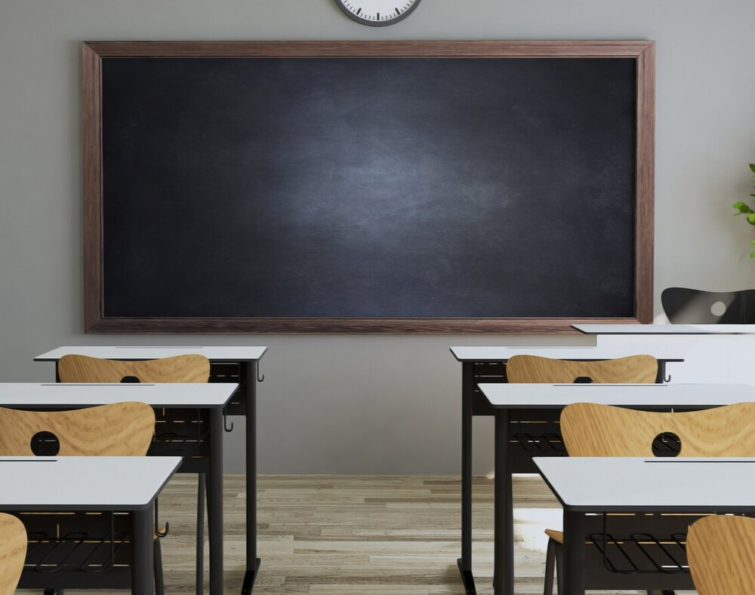
FREQUENT PROBLEMS REGARDING COURSES AND CLASSROOM LAYOUT

Slide 3
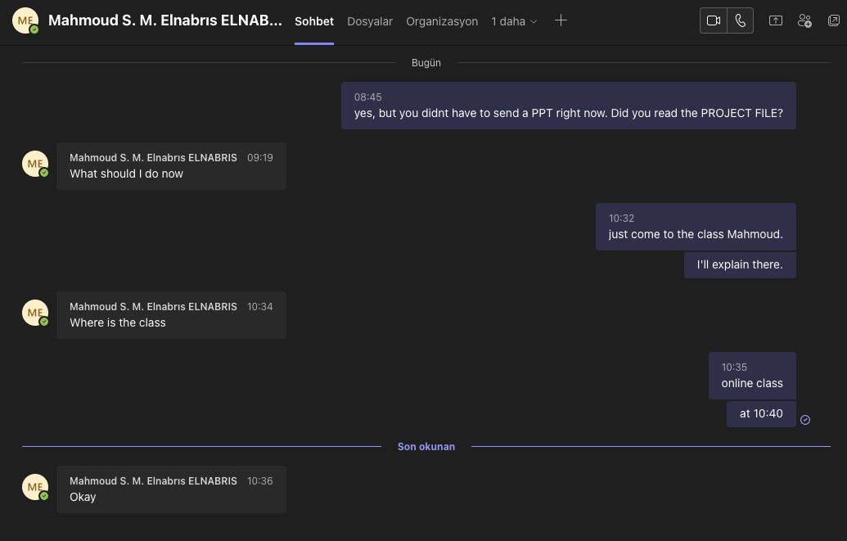
It is the student's responsibility to follow the course content, course hours and project & portfolio dates.

Slide 4
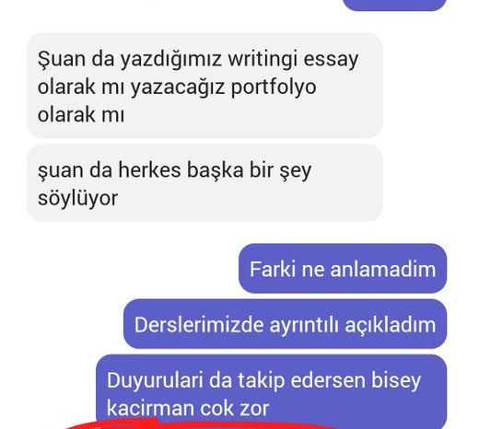

Slide 5
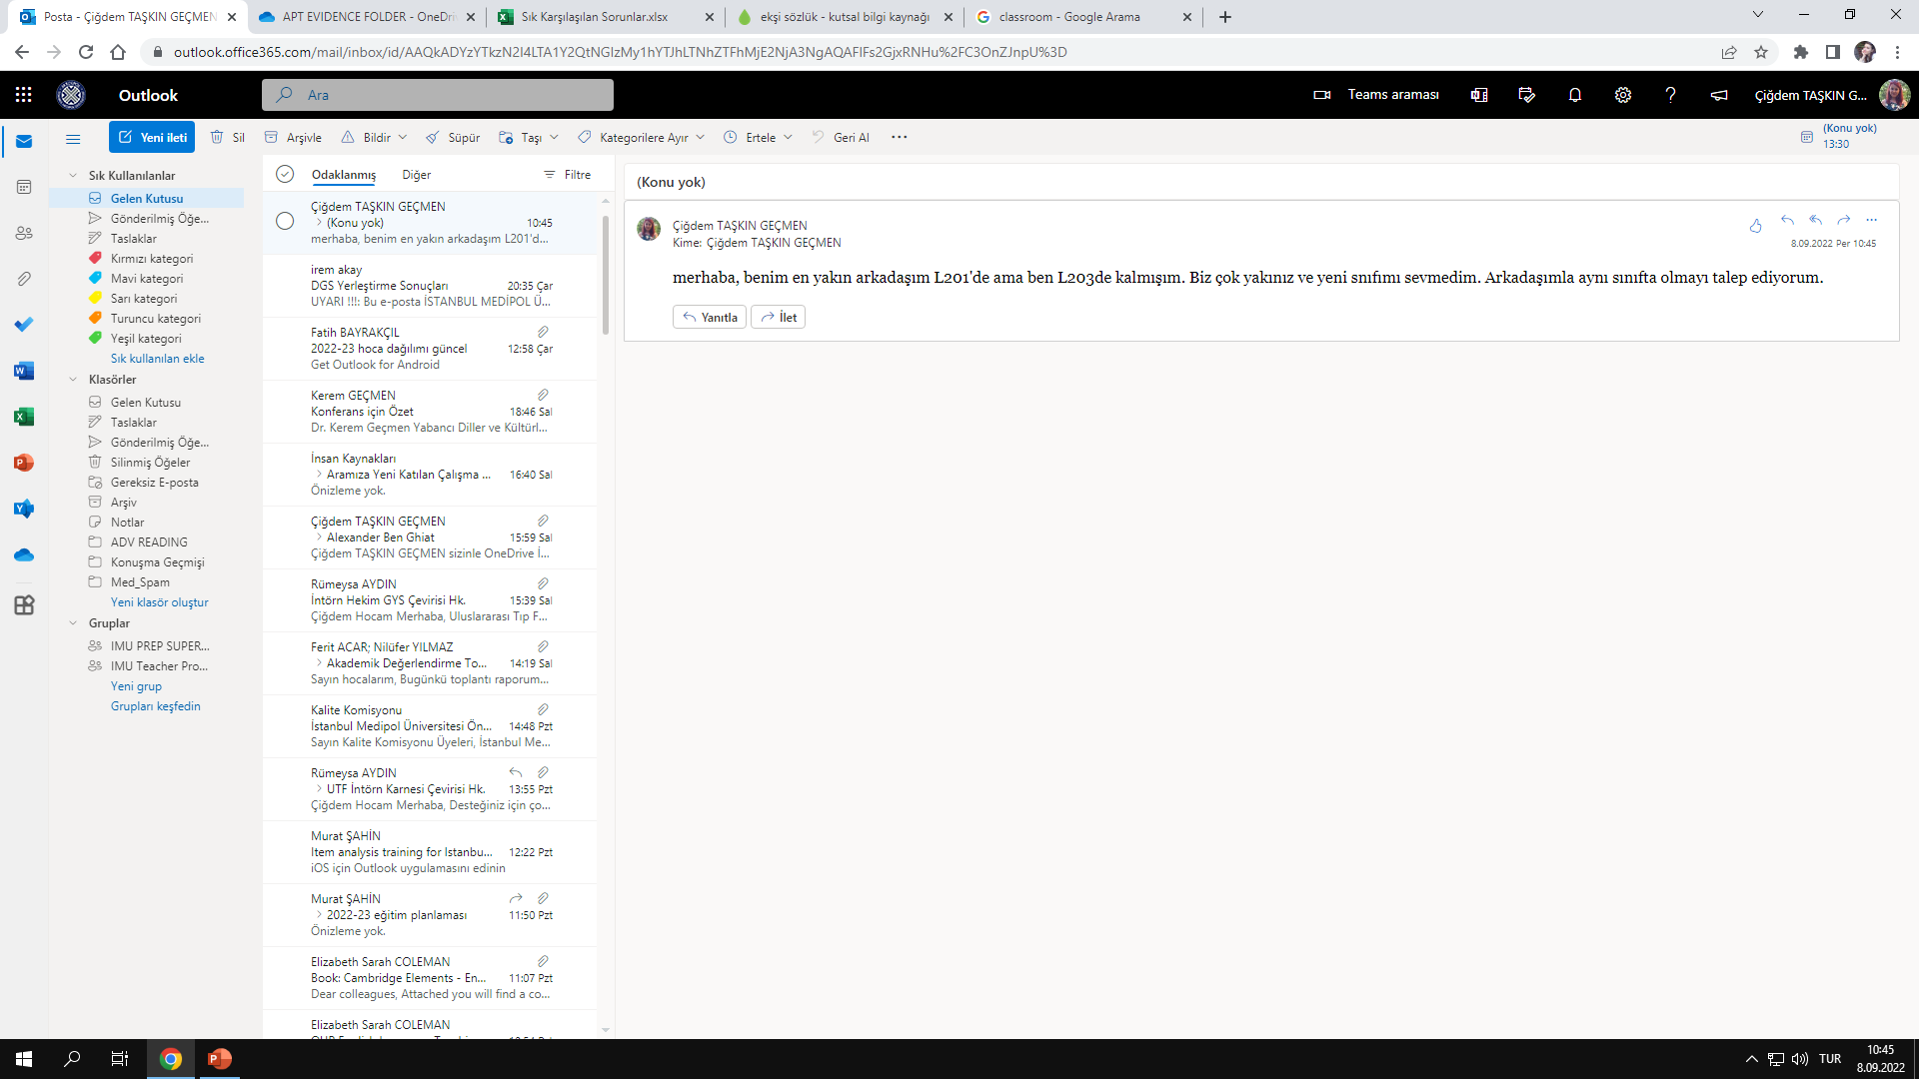
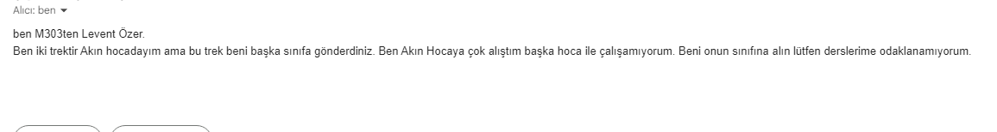
Students are placed in their classes based on their average grade.
Class change cannot be requested due to reasons such as close friend, favorite teacher, relatives etc. being in another class.

Slide 6

FREQUENT PROBLEMS WITH EXAMS

Slide 7
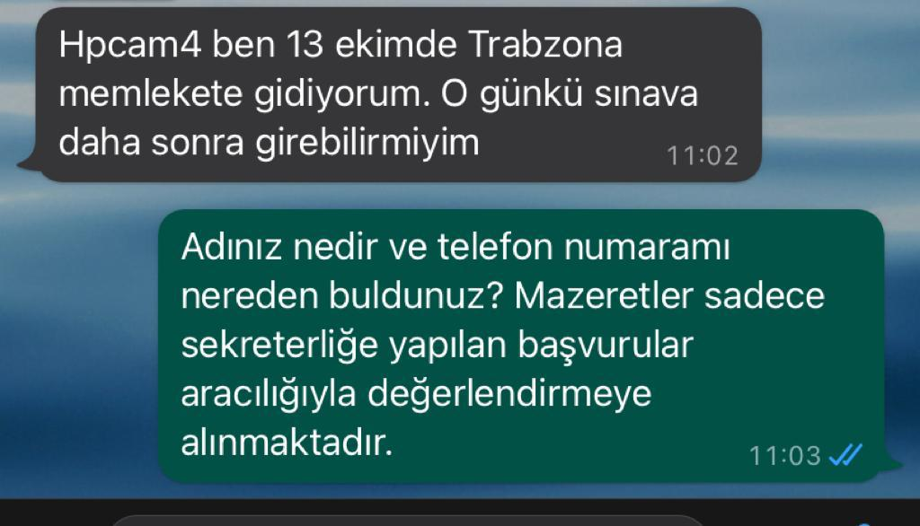
Students cannot request changes in the exam day and/or time due to personal reasons.

Slide 8
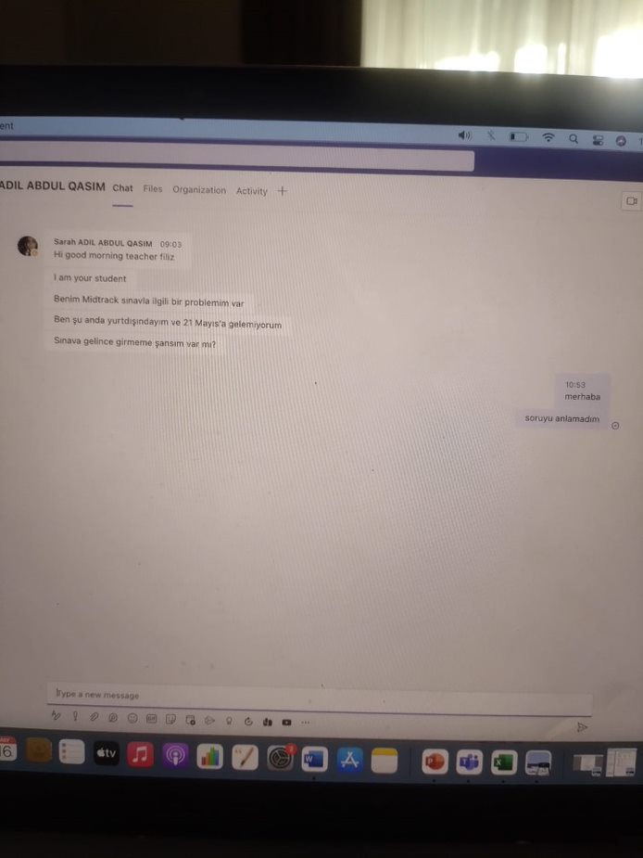

Slide 9
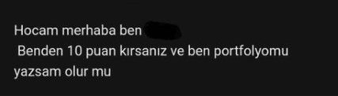
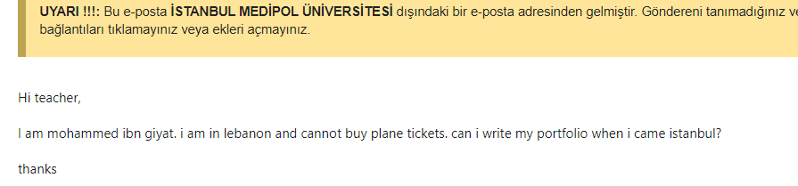
Project presentations and portfolio writings are also subject to assessment & evaluation. Therefore, the days of project presentations or portfolio writings are also done with the seriousness of the exam.
Changes cannot be requested for personal reasons during these days.
Health reports cannot be accepted for students who miss Project and Portfolio days.
Additionally Health Reports cannot be accepted for all missed assessment stages (Project, Portfolio, Presentations, Proficiency, P.L.A.T, P.L.A.T-Make Up) except Mid-Track Exam (MTE) and Track Achievement Test (TAT)​

Slide 10

FREQUENT PROBLEMS REGARDING COMPLAINTS

Slide 11
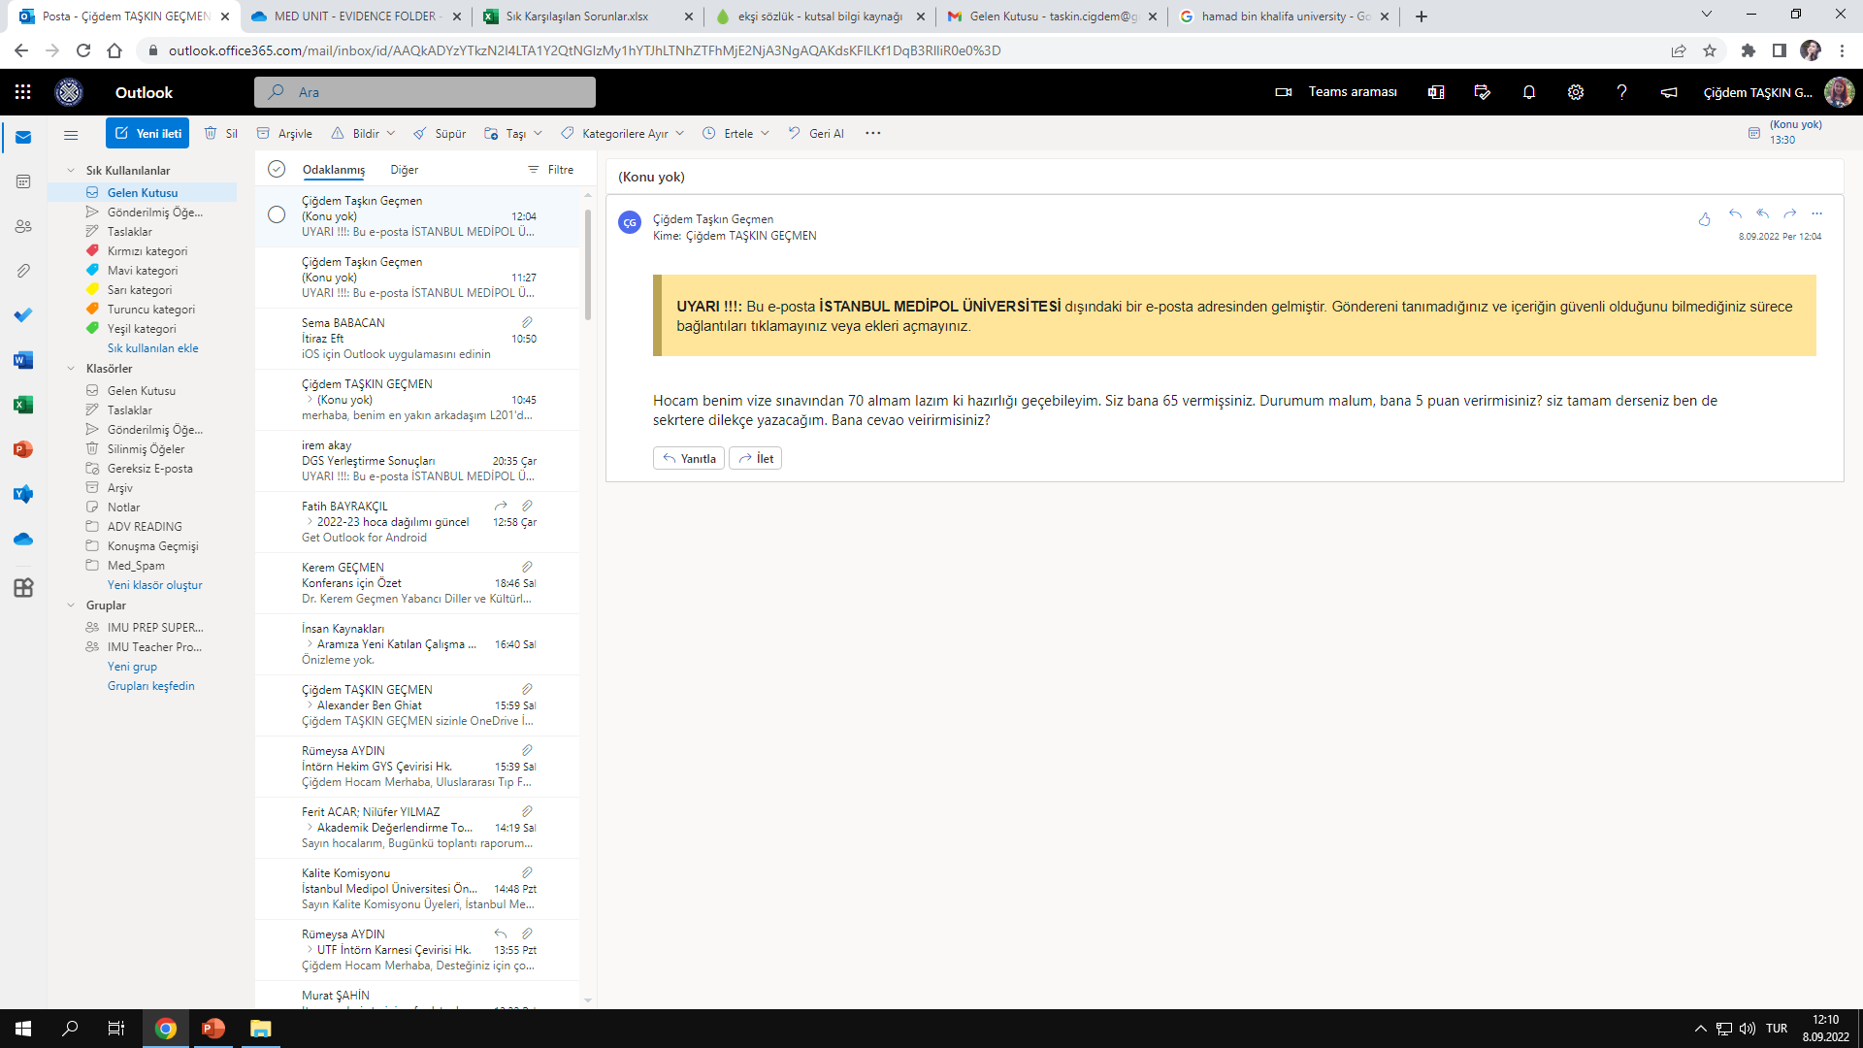
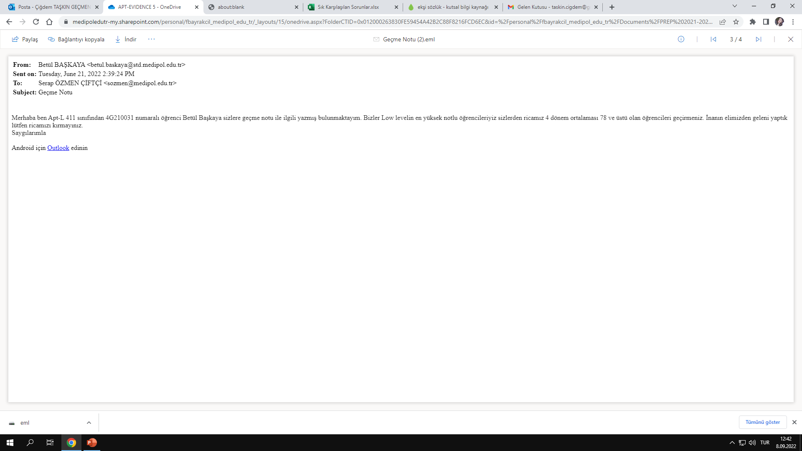
Our students can object to the exam grade within 5 working days following the announcement of the grades.
Appeal petitions for MTE and/or TAT must be sent to the Preparatory School secretariat via e-mail. (For a sample petition, please visit dilokulu.medipol.edu.tr.)
The petition should not be submitted according to the note that you think you should receive.

Slide 12
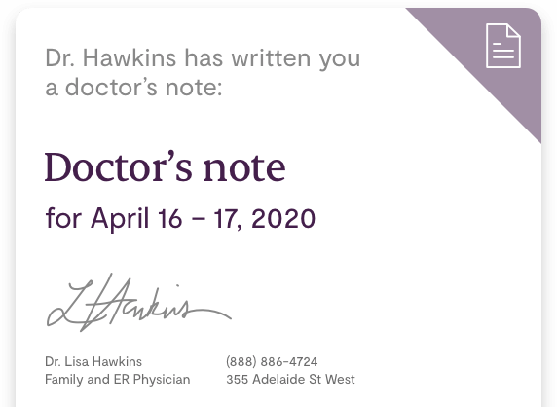
FREQUENT PROBLEMS REGARDING HEALTH REPORT SUBMISSION

Slide 13
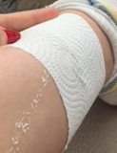
You can make up missed exams (MTE and/or TAT) by obtaining a valid hospital report and submitting it within 5 business days following the announcement of grades. The make-up exam date will be announced subsequently.
Unofficial, unsigned, unstamped documents, prescriptions and rest notes are not a substitute for a report.
Reports received from abroad must be certified by a notary or the consulates of the relevant country.

Slide 14
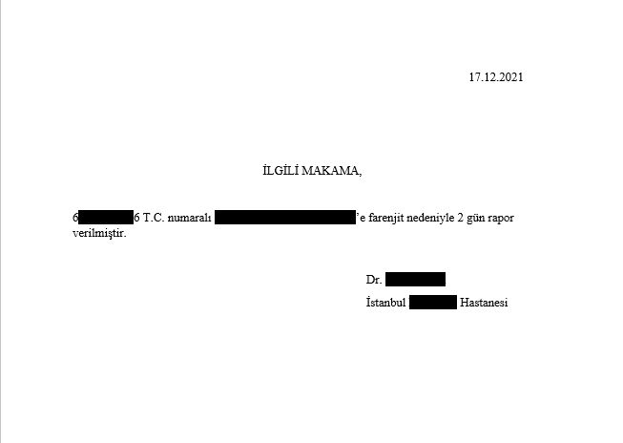
No signature
No stamp
No hospital logo
It is clear that this is not a valid report.

Slide 15
IMPORTANT REMINDER!

Slide 16
You should establish your communication with your instructors from the e-mail addresses of the lecturers with the extension «@medipol.edu.tr».
SMS, WhatsApp message, correspondence over Microsoft Teams, messaging over social media platforms should definitely not be preferred.

Slide 17
It is the student's responsibility to provide the necessary equipment (computer, good internet connection, etc.) for online exams. Istanbul Medipol University is not responsible for any technical errors that may occur.
Students are obliged to turn on their cameras during online speaking exams. Behaviors such as participating in online exams in pajamas and smoking cigarettes are not appropriate for students who are expected to take the exam seriously.

Slide 18
We wish you all a smooth and enjoyable academic year ☺

